Slide 1
Computer Networks (CS-241)
Dr Syed Muhammad Mohsin,
Department of Computer Science,
University of Wah
Adapted From:
Computer Networking: A Top-Down Approach 8th edition: Jim Kurose, Keith Ross Pearson, 2020

Slide 2
Network-layer functions
forwarding: move packets from router’s input to appropriate router output
data plane
routing: determine route taken by packets from source to destination
control plane
Two approaches to structuring network control plane:
per-router control (traditional)
logically centralized control (software defined networking)

Slide 3

Per-router control plane
Individual routing algorithm components in each and every router interact in the control plane
Routing
Algorithm
control
plane
data
plane
values in arriving
packet header
0111
1
3
2

Slide 4
Software-Defined Networking (SDN) control plane
Remote controller computes, installs forwarding tables in routers
Remote Controller
control
plane
data
plane
CA
CA
CA
CA
CA
values in arriving
packet header
0111
1
3
2

Slide 5
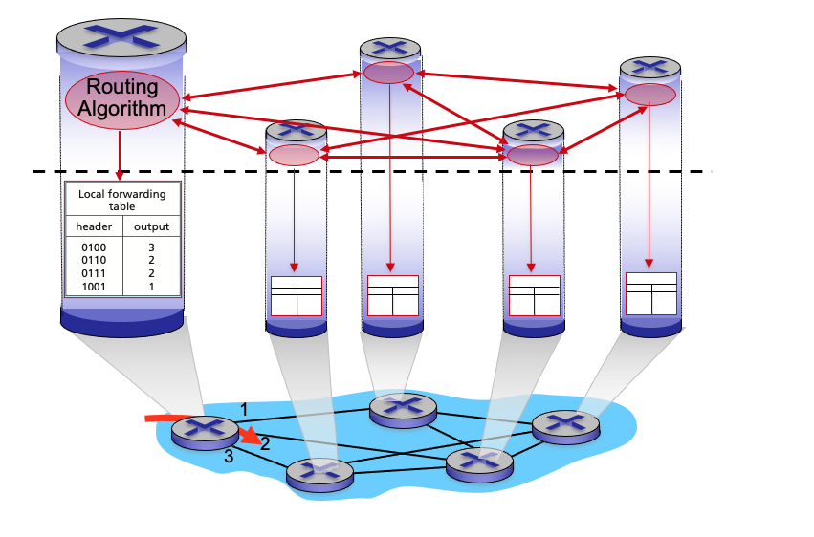
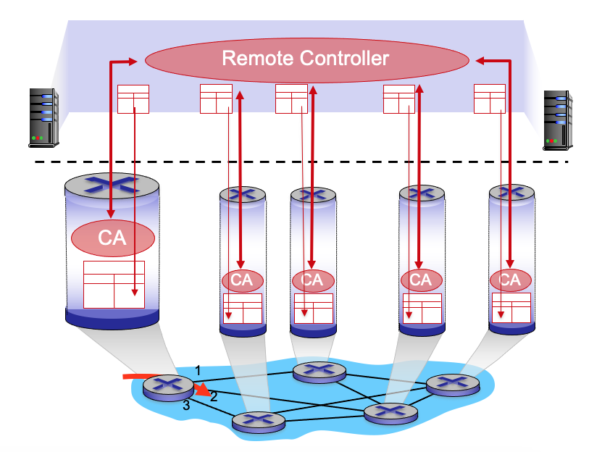
Per-router control plane
SDN control plane

Slide 6

Network layer: “control plane” roadmap
introduction
routing protocols
link state
distance vector
intra-ISP routing: OSPF
routing among ISPs: BGP
SDN control plane
Internet Control Message Protocol
network management, configuration
SNMP
NETCONF/YANG

Slide 7
















Routing protocols
mobile network
Routing protocol goal: determine “good” paths (equivalently, routes), from sending hosts to receiving host, through network of routers
path: sequence of routers packets traverse from given initial source host to final destination host
“good”: least “cost”, “fastest”, “least congested”
routing: a “top-10” networking challenge!
national or global ISP
application
transport
network
link
physical
network
link
physical
network
link
physical
network
link
physical
network
link
physical
network
link
physical
datacenter
network
application
transport
network
link
physical
enterprise
network

Slide 8
Graph abstraction: link costs
c_{a,b}: cost of direct link connecting a and b
e.g., c_{w,z} = 5, c_{u,z} = ∞
Link cost of 2 nodes that are not connected directly is infinity.
Cost defined by network operator could always be 1, or inversely related to bandwidth (higher bandwidth – lower cost), or inversely related to congestion (higher congestion – higher cost)
5
v
3
w
2
5
u
2
1
z
3
1
2
x
y
1
graph: G = (N,E)
N: set of routers = { u, v, w, x, y, z }
E: set of links ={ (u,v), (u,x), (v,x), (v,w), (x,w), (x,y), (w,y), (w,z), (y,z) }

Slide 9
Routing algorithm classification
global: all routers have complete topology, link cost info
“link state” algorithms
dynamic: routes change more quickly
periodic updates or in response to link cost changes
How fast do routes change?
static: routes change slowly over time
decentralized: iterative process of computation, exchange of info with neighbors
routers initially only know link costs to attached neighbors
“distance vector” algorithms
global or decentralized information?

Slide 10
Network layer: “control plane” roadmap
introduction
routing protocols
link state
distance vector
intra-ISP routing: OSPF
routing among ISPs: BGP
SDN control plane
Internet Control Message Protocol
network management, configuration
SNMP
NETCONF/YANG

Slide 11
Dijkstra’s link-state routing algorithm
Dijkstra’s algorithm is the core algorithm used by link-state routing protocols to compute the shortest path from a source router to all other routers in a network.
In computer networks, it is most commonly used by OSPF (Open Shortest Path First) and IS-IS protocols.
The algorithm ensures that packets are forwarded along the least-cost path, improving efficiency, reliability, and overall network performance.
IS-IS (Intermediate System to Intermediate System) is a link-state Interior Gateway Protocol (IGP) used to route IP packets within a single autonomous system (AS). It is widely deployed in large enterprise and ISP networks because of its scalability and stability.
IS-IS allows routers to exchange link-state information and compute the shortest paths using Dijkstra’s algorithm.

Slide 12
Role of Dijkstra’s Algorithm in Link-State Routing
In link-state routing, each router independently builds a complete map of the network topology.
This map is created using information shared by all routers in the form of Link State Advertisements (LSA is a packet that contains information about a router, its links, and network reachability, which is shared with other routers to build a complete network map).
Once the topology is known, Dijkstra’s algorithm is applied to calculate the shortest path tree (SPT) with the router itself as the root.
From this tree, the router constructs its routing table.

Slide 13
Dijkstra’s link-state routing algorithm
centralized: network topology, link costs known to all nodes
accomplished via “link state broadcast”
all nodes have same info
computes least cost paths from one node (“source”) to all other nodes
gives forwarding table for that node
iterative: after k iterations, know least cost path to k destinations
notation
c_{x,y}: direct link cost from node x to y; = ∞ if not direct neighbors
D(v): current estimate of cost of least-cost-path from source to destination v
p(v): predecessor node along path from source to v
N': set of nodes whose least-cost-path definitively known

Slide 14
Dijkstra’s link-state routing algorithm
1 Initialization:
2 N' = {u} /* compute least cost path from u to all other nodes */
3 for all nodes v
4 if v adjacent to u /* u initially knows direct-path-cost only to direct neighbors */
5 then D(v) = c_{u,v} /* but may not be minimum cost! */
6 else D(v) = ∞
7
notation
8 Loop
9
10
11
12
13
14
15 until all nodes in N'
find w not in N' such that D(w) is a minimum
add w to N'
update D(v) for all v adjacent to w and not in N' :
D(v) = min ( D(v), D(w) + c_{w,v} )
/* new least-path-cost to v is either old least-cost-path to v or known
least-cost-path to w plus direct-cost from w to v */
c_{x,y}: direct link cost from node x to y; = ∞ if not direct neighbors
D(v): current estimate of cost of least-cost-path from source to destination v
p(v): predecessor node along path from source to v
N': set of nodes whose least-cost-path definitively known

Slide 15
Dijkstra’s algorithm: an example
v
w
x
y
z
Step
0
1
2
3
4
5
N'
D(v),p(v)
D(w),p(w)
D(x),p(x)
D(y),p(y)
D(z),p(z)
u
2,u
5,u
1,u
∞
∞
D(w),p(w)
5,u
4,x
3,y
3,y
5
Initialization (step 0):
For all a: if a adjacent to u then D(a) = c_{u,a}
v
3
w
2
5
u
2
1
z
3
1
2
x
y
1

Slide 16
Dijkstra’s algorithm: an example
v
w
x
y
z
Step
0
1
2
3
4
5
N'
D(v),p(v)
D(w),p(w)
D(x),p(x)
D(y),p(y)
D(z),p(z)
u
2,u
5,u
1,u
∞
∞
ux
8 Loop
9
10
find a not in N' such that D(a) is a minimum
add a to N'
5
v
3
w
2
5
u
2
1
z
3
1
2
x
y
1

Slide 17

Dijkstra’s algorithm: an example
v
w
x
y
z
Step
0
1
2
3
4
5
N'
D(v),p(v)
D(w),p(w)
D(x),p(x)
D(y),p(y)
D(z),p(z)
u
2,u
5,u
1,u
∞
∞
ux
2,u
4,x
2,x
∞
8 Loop
9
10
11
find a not in N' such that D(a) is a minimum
add a to N'
5
v
3
w
2
5
update D(b) for all b adjacent to a and not in N' :
D(b) = min ( D(b), D(a) + c_{a,b} )
u
2
1
z
3
1
2
D(v) = min ( D(v), D(x) + c_{x,v} ) = min(2, 1+2) = 2
x
y
1
D(w) = min ( D(w), D(x) + c_{x,w} ) = min (5, 1+3) = 4
D(y) = min ( D(y), D(x) + c_{x,y} ) = min(inf,1+1) = 2

Slide 18
Dijkstra’s algorithm: an example
v
w
x
y
z
Step
0
1
2
3
4
5
N'
D(v),p(v)
D(w),p(w)
D(x),p(x)
D(y),p(y)
D(z),p(z)
u
2,u
5,u
1,u
∞
∞
ux
2,u
4,x
2,x
∞
uxy
D(w),p(w)
5,u
4,x
3,y
3,y
8 Loop
9
10
find a not in N' such that D(a) is a minimum
add a to N'
5
v
3
w
2
5
u
2
1
z
3
1
2
x
y
1

Slide 19
Dijkstra’s algorithm: an example
v
w
x
y
z
Step
0
1
2
3
4
5
N'
D(v),p(v)
D(w),p(w)
D(x),p(x)
D(y),p(y)
D(z),p(z)
u
2,u
5,u
1,u
∞
∞
ux
2,u
4,x
2,x
∞
uxy
2,u
3,y
4,y
8 Loop
9
10
11
find a not in N' such that D(a) is a minimum
add a to N'
5
v
3
w
2
5
update D(b) for all b adjacent to a and not in N' :
D(b) = min ( D(b), D(a) + c_{a,b} )
u
2
1
z
3
1
2
D(w) = min ( D(w), D(y) + c_{y,w} ) = min (4, 2+1) = 3
x
y
1
D(z) = min ( D(z), D(y) + c_{y,z} ) = min(inf,2+2) = 4

Slide 20
Dijkstra’s algorithm: an example
v
w
x
y
z
Step
0
1
2
3
4
5
N'
D(v),p(v)
D(w),p(w)
D(x),p(x)
D(y),p(y)
D(z),p(z)
u
2,u
5,u
1,u
∞
∞
ux
2,u
4,x
2,x
∞
uxy
2,u
3,y
4,y
uxyv
8 Loop
9
10
find a not in N' such that D(a) is a minimum
add a to N'
5
v
3
w
2
5
u
2
1
z
3
1
2
x
y
1

Slide 21
Dijkstra’s algorithm: an example
v
w
x
y
z
Step
0
1
2
3
4
5
N'
D(v),p(v)
D(w),p(w)
D(x),p(x)
D(y),p(y)
D(z),p(z)
u
2,u
5,u
1,u
∞
∞
ux
2,u
4,x
2,x
∞
uxy
2,u
3,y
4,y
uxyv
3,y
4,y
8 Loop
9
10
11
find a not in N' such that D(a) is a minimum
add a to N'
5
v
3
w
2
5
update D(b) for all b adjacent to a and not in N' :
D(b) = min ( D(b), D(a) + c_{a,b} )
u
2
1
z
3
1
2
D(w) = min ( D(w), D(v) + c_{v,w} ) = min (3, 2+3) = 3
x
y
1

Slide 22
Dijkstra’s algorithm: an example
v
w
x
y
z
Step
0
1
2
3
4
5
N'
D(v),p(v)
D(w),p(w)
D(x),p(x)
D(y),p(y)
D(z),p(z)
u
2,u
5,u
1,u
∞
∞
ux
2,u
4,x
2,x
∞
uxy
2,u
3,y
4,y
uxyv
3,y
4,y
uxyvw
8 Loop
9
10
find a not in N' such that D(a) is a minimum
add a to N'
5
v
3
w
2
5
u
2
1
z
3
1
2
x
y
1

Slide 23
Dijkstra’s algorithm: an example
v
w
x
y
z
Step
0
1
2
3
4
5
N'
D(v),p(v)
D(w),p(w)
D(x),p(x)
D(y),p(y)
D(z),p(z)
u
2,u
5,u
1,u
∞
∞
ux
2,u
4,x
2,x
∞
uxy
2,u
3,y
4,y
uxyv
3,y
4,y
uxyvw
4,y
8 Loop
9
10
11
find a not in N' such that D(a) is a minimum
add a to N'
5
v
3
w
2
5
update D(b) for all b adjacent to a and not in N' :
D(b) = min ( D(b), D(a) + c_{a,b} )
u
2
1
z
3
1
2
D(z) = min ( D(z), D(w) + c_{w,z} ) = min (4, 3+5) = 4
x
y
1

Slide 24
Dijkstra’s algorithm: an example
v
w
x
y
z
Step
0
1
2
3
4
5
N'
D(v),p(v)
D(w),p(w)
D(x),p(x)
D(y),p(y)
D(z),p(z)
u
2,u
5,u
1,u
∞
∞
ux
2,u
4,x
2,x
∞
uxy
2,u
3,y
4,y
uxyv
3,y
4,y
uxyvw
4,y
uxyvwz
8 Loop
9
10
find a not in N' such that D(a) is a minimum
add a to N'
5
v
3
w
2
5
u
2
1
z
3
1
2
x
y
1

Slide 25
Dijkstra’s algorithm: an example
v
w
x
y
z
Step
0
1
2
3
4
5
N'
D(v),p(v)
D(w),p(w)
D(x),p(x)
D(y),p(y)
D(z),p(z)
u
2,u
5,u
1,u
∞
∞
ux
2,u
4,x
2,x
∞
uxy
2,u
3,y
4,y
uxyv
3,y
4,y
uxyvw
4,y
uxyvwz
8 Loop
9
10
11
find a not in N' such that D(a) is a minimum
add a to N'
5
v
3
w
2
5
update D(b) for all b adjacent to a and not in N' :
D(b) = min ( D(b), D(a) + c_{a,b} )
u
2
1
z
3
1
2
x
y
1

Slide 26
Dijkstra’s algorithm: an example
v
w
x
y
z
Step
0
1
2
3
4
5
N'
D(v),p(v)
D(w),p(w)
D(x),p(x)
D(y),p(y)
D(z),p(z)
u
2,u
5,u
1,u
∞
∞
ux
2,u
4,x
2,x
∞
uxy
2,u
3,y
4,y
uxyv
3,y
4,y
uxyvw
4,y
uxyvwz
Initialization (step 0): For all a: if a adjacent to then D(a) = c_{u,a}
5
find a not in N' such that D(a) is a minimum
add a to N'
update D(b) for all b adjacent to a and not in N' :
D(b) = min ( D(b), D(a) + c_{a,b} )
v
3
w
2
5
u
2
1
z
3
1
2
x
y
1

Slide 27
Dijkstra’s algorithm: an example
5
v
3
w
2
5
u
2
1
z
3
1
2
x
y
1
resulting least-cost-path tree from u:
resulting forwarding table in u:
v
w
destination
outgoing link
v
x
y
w
z
(u,v)
(u,x)
(u,x)
(u,x)
(u,x)
route from u to v directly
u
z
x
route from u to all other destinations via x
y

